Slide 1
Information Theory
Dr. William Hutton
Washington State University

Slide 2
Overview
The World of Theories
Origins of Information Theory
Mathematical Model
Encoding and Binary Digits
Entropy
Language and Meaning
Efficient Encoding
Noisy Channels
Notes:
First half of “An Introduction to Information Theory” (Pierce 1980)

Slide 3
The World of theories
Claude Shannon publishes “A Mathematical Theory of Communication” in 1948.
In 1949 Shannon’s paper was published in book form as “The Mathematical Theory of Communication” (actually two papers):
Unpublished Scientific American article
Bell Labs Technical Journal July & October 1948
English philosopher A.J. Ayer 1910 – 1989) comments on the wide meaning and importance of communication: we communicate not only information but knowledge, error, opinion, ideas, experiences, wishes, orders, emotions, feelings and moods.
Heat and motion can be communicated. So can strength, weakness, and disease.
Notes:
The slight change in the title is both trivial and profound. -- Blahut & Hajek (Forward to “The Mathematical Theory of Communication” (Shannon / Weaver 1998)
16th printing, Still sells ~1,000 copies a year half a century later.
Required reading in many information theory courses. You are all at the beginning of your careers—maybe one day your work will be as influential?

Slide 4
Communication
Communication is used in the broadest sense possible: ”How does one mind affect another mind?” (Weaver)
Notes:
Weaver worked with Shannon to publish his papers in book form in 1949.
Communication involves not just written and oral speech, but music, pictures, art, theater, ballet—all human behavior.
In an even broader sense, it is the means that one mechanism affects another (e.g., a guided missile computing the probable future position of an airplane).

Slide 5
Communication Problems
Three Levels of Communication Problems
How accurately can the symbols of communication be transmitted? (Level A: The technical problem)
How precisely do the transmitted symbols convey the desired meaning? (Level B: The semantic problem)
How effectively does the received meaning affect conduct in the desired way? (Level C: The effectiveness problem)
Notes:
Computer scientists operate primarily on the technical problem.
Philosophers on the semantic problem.
Who works on the effectiveness problem?

Slide 6
Information
Source
Transmitter
Receiver
Destination
Message
Signal
Received Signal
Message
Noise
Source
Notes:
The information source selects a desired message from a set of possible messages. [Important! Requires much work later.]
Transmitter changes the message into a signal, which is sent over a communication channel to the receiver.
Receiver is an ”inverse transmitter”, converting the received signal back into a message.
Things are added to the signal that were not intended by the information source via noise.
Discuss examples: POTS, Cell Phones, conversation, print, art, etc. What are the channels, transmitters, receivers, noise sources, etc.

Slide 7
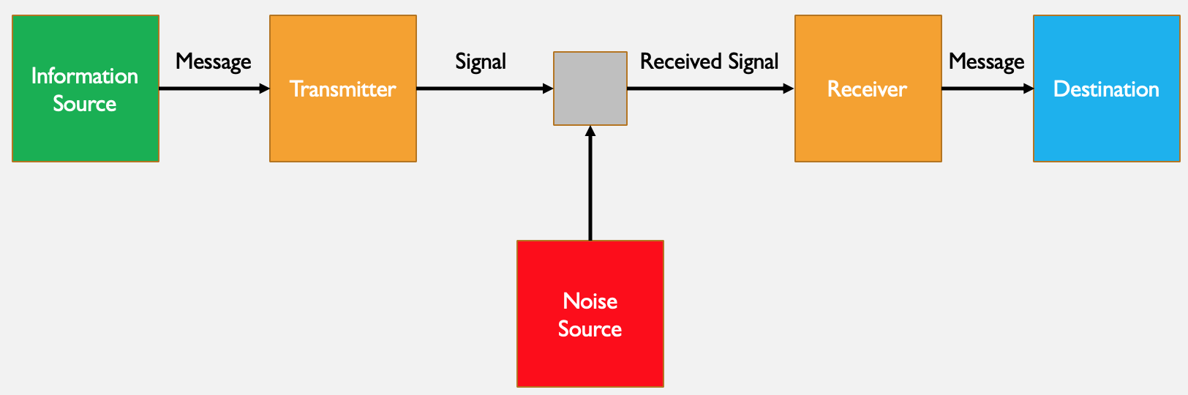
Questions concerning communication systems
How do you measure the amount of information?
How do you measure the capacity of a communication channel?
What is the most efficient encoding for a transmitter?
What are the sources of noise and how can they be minimized?
How do continuous transmissions (e.g., speech and music) differ from discrete transmissions (e.g., written words)?

Slide 8
What is information?
The quick brown fox jumps over the lazy dog.
Xfoql rxkhr jffju jzlpw cfwkc yjff jeyvk cq.
Notes:
Don’t confuse information with meaning. (This could be an example of the semantic problem.). More communication in the second case will not clear up any misunderstanding between the sender and the receiver.)
”The semantic aspects of communication are irrelevant to the engineering aspects.” (Shannon)

Slide 9
What is information?
Information is a measure of one’s freedom of choice when selecting a message. (sender)
Information is a measure of surprise when receiving a message. (receiver)
Notes:
Who’s read Orwell’s “1984”? How does it relate to this definition of information?
How would you define information in terms of the receiver?

Slide 10
Possible Messages
1
0: Just why Peter Samson was wandering around in Building 26 in the middle of the night was a matter that he would find difficult to explain.
0
1: Yes.
t₀
t_{i}
t_{i+1}
Notes:
In this case, when the sender only has two choices for the message, they can be digitally encoded as a 0 or a 1.
Even though the first message (0) has more words, it conveys the same amount of information (one bit) as the much shorter message of “yes”.
Source of message 0, the opening sentence of “Hackers: Heroes of the Computer Revolution” (Levy1984)

Slide 11
What is information?
Possible Messages
To be more definite, in the simplest terms, information is the log of the available choice of messages.
Log base 2 is convenient for working with bits.
0: Just why Peter Samson was wandering around in Building 26 in the middle of the night was a matter that he would find difficult to explain.
1: Yes.
Notes:
Bit: binary digit (John Tukey)

Slide 12
Information
Word | Bits
the | 000
man | 001
to | 010
runs | 011
house | 100
likes | 101
horse | 110
sell | 111
Notes:
8 choices of words to transmit. Log base 2 of 8 is 3, so we need three bits to transmit any one word as a discrete message.

Slide 13
Information
Word | Bits | Probability
the | 000 | .5
man | 001 | .15
to | 010 | .12
runs | 011 | .10
house | 100 | .04
likes | 101 | .04
horse | 110 | .03
sell | 111 | .02
Notes:
Remember, information from the receiver’s point of view is a measure of surprise (entropy). If the word ”the” is sent with 50% probability, we shouldn’t be as surprised when we see the word “sell”.
So we can use clever encoding schemes like Adaptive Huffman encoding to account for probability and transmit more often used words with fewer bits.

Slide 14
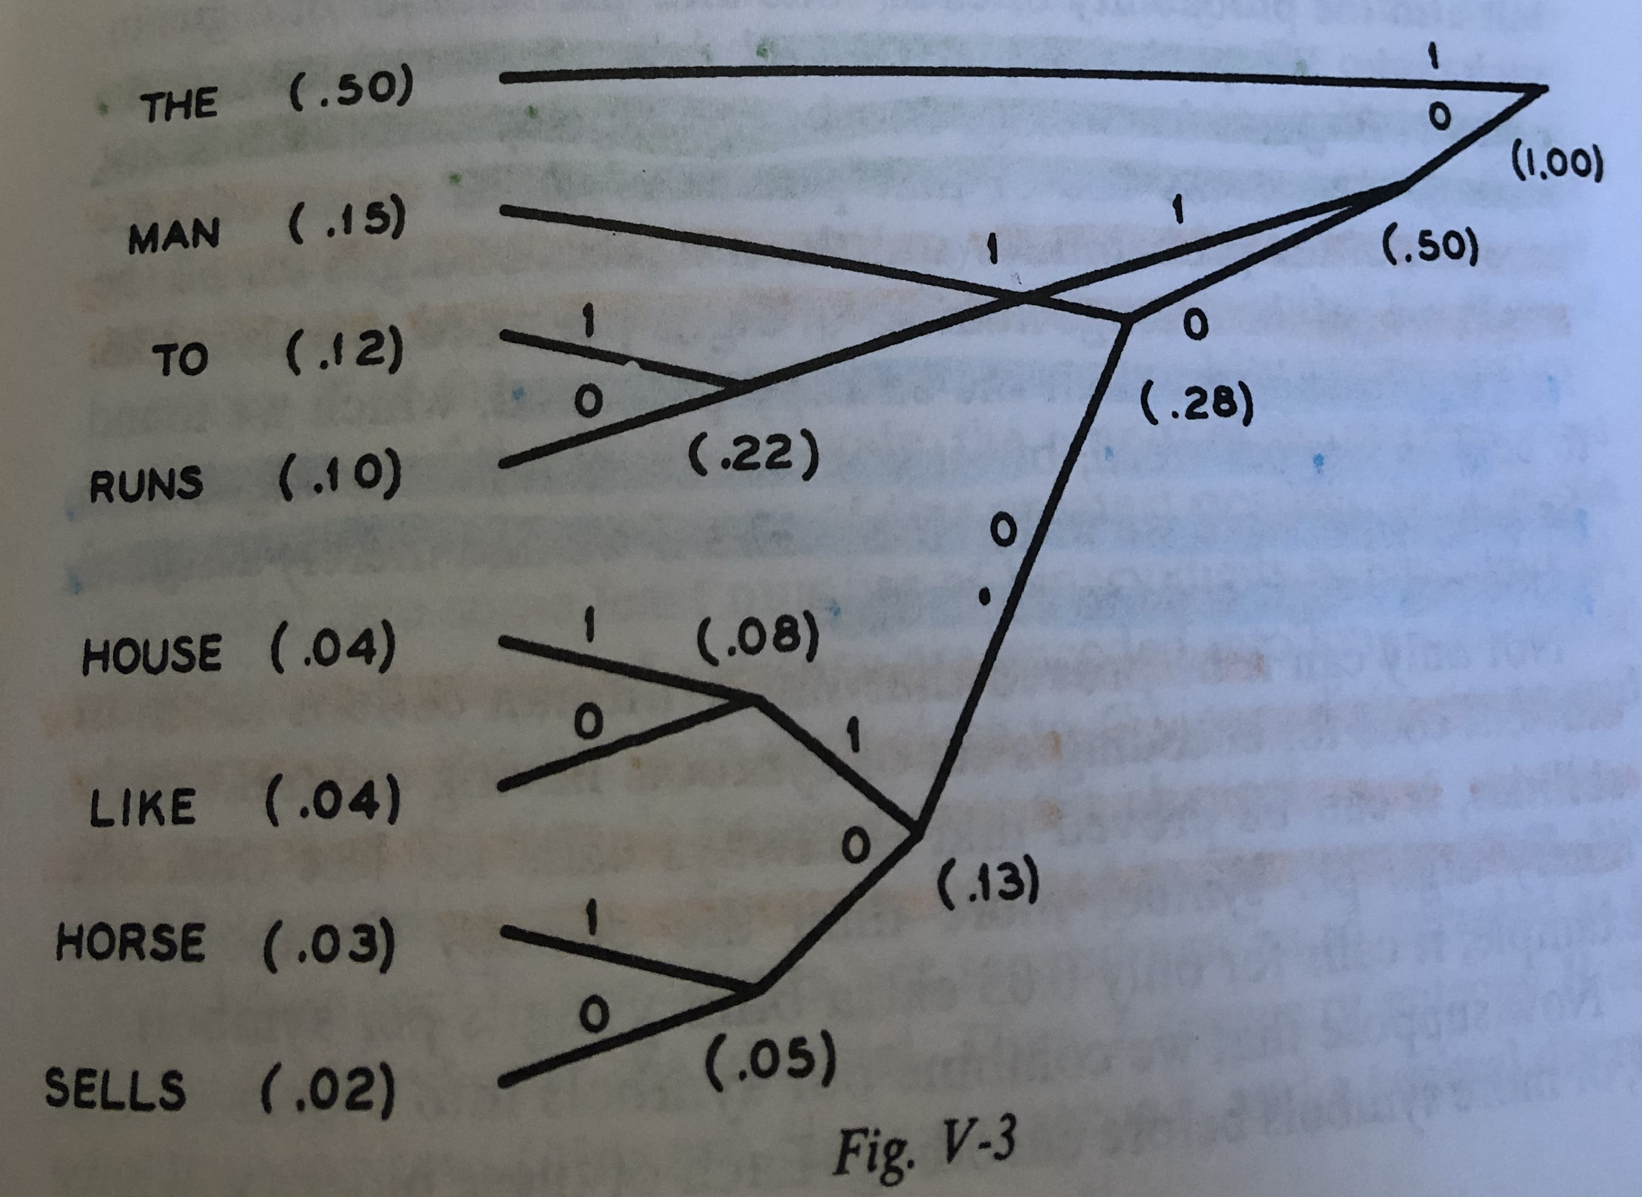
1 001 010 011 1 00011
Notes:
Source: (Pierce 1980)
Binary tree with probabilities. Lower probabilities require more bits to transmit.
The man runs to the house (1 001 010 011 1 00011) is 7 words, but only need 16 bits to transmit not 21. Only 66% of the bits we would expect to need.

Slide 15
Information
Word | Original Bits | Probability | New Bits
the | 000 | .5 | 1
man | 001 | .15 | 001
to | 010 | .12 | 011
runs | 011 | .10 | 010
house | 100 | .04 | 00011
likes | 101 | .04 | 00010
horse | 110 | .03 | 00001
sell | 111 | .02 | 00000

Slide 16
Entropy
H = - log 1 / n bits per symbol
Assumes equal probability of every symbol (languages do not do this!)
Probability of any one symbol is 1 / n (where n is number of symbols)

Slide 17
Zero-order approximation
Symbols are independent and equi-probable:
Symbols are A-Z (English alphabet)
XFOML RXKHRJFFJUJ ZLPWCFWKCYJ FFJEYVKCQSGHYD QPAAMKBZAACIBZLHJQD

Slide 18
First-order approximation
Symbols are independent with frequency of English text:
OCRO HLI RGWR NMIELWIS EU LL NBNESEBYA TH EEI ALHENHTTPA OOBTTVA NAH BRL.

Slide 19
SECOND-ORDER approximation
Conditional probability (di-grams) and frequency of English letters pT(H) = .37:
ON IE ANTSOUTINYS ARE T INCTORE ST BE S DEAMY ACHIN D ILONASIVE TUCOOWE AT TEASONARE TUSO TIZIN ANDY TOBE SEACE CTISBE.
Notes:
Given the letter ‘T’, there is a 37% chance the following letter will be an ‘H’.

Slide 20
THIRD-ORDER approximation
Conditional probability (tri-grams):
IN NO IST LAT WHEY CRATICT FROURE BIRS GROCID PONDENOME OF DEMONSTURES OF THE REPTAGIN IS REGOACTIONAOF CRE
Notes:
Same as diagrams, but any given letter takes into account the probability of the preceding TWO characters.
Increasing resemblance to English. (Harry Potter spell?)

Slide 21
Additional Resources
An Introduction to Information Theory: Symbols, Signals and Noise (Pierce 1980)
The Mathematical Theory of Communication (Shannon, Weaver 1998)
Episode 2: Information Theory (Art of the Problem 2018)
A Word is Worth a Thousand Pictures (Eklund 2014) [Available on BlackBoard in the Content section]

